Slide 1

HEALTHIFY Group – 01 Mentor: Dr. Charles Badami Course: 44691-01

Slide 2
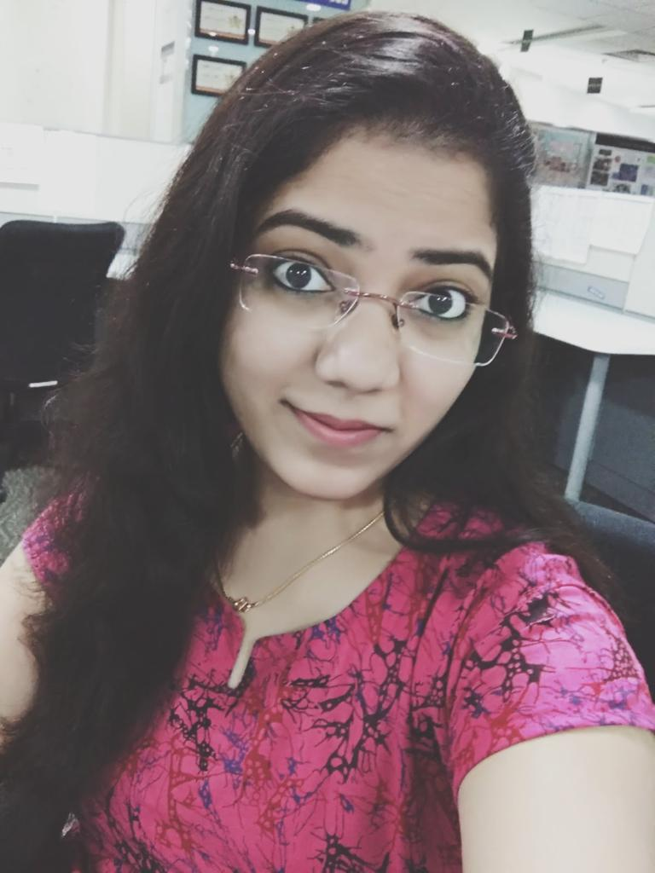

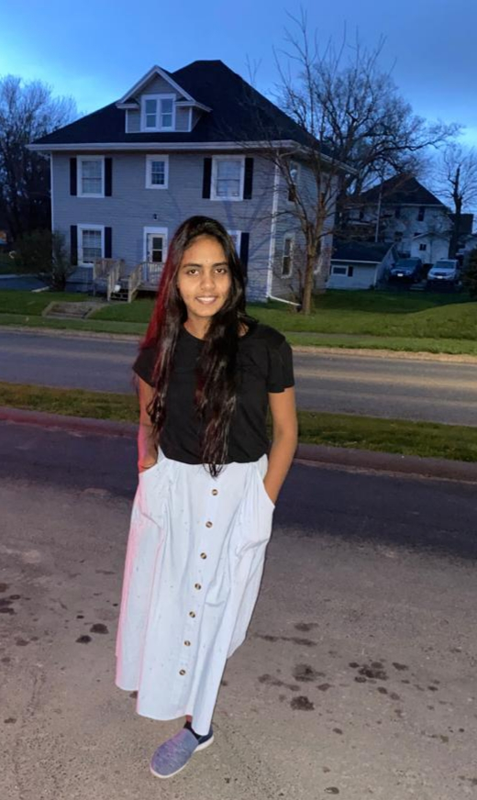

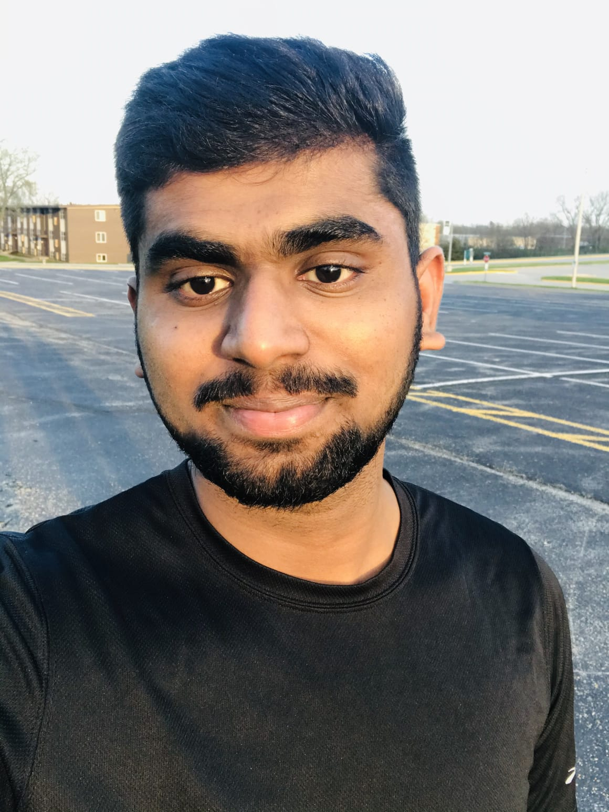
Group Members
Sowmya Thogiti Vineetha Yenugula Swaroopa Naga Anshitha Shiva Rama
(Project Manager) (Fullstack Developer) Thirumalareddy Velagapudi Krishna Vodnala
(Backend Developer) (UI and Tester) (DB Administrator)

Slide 3
Requirements
The text narrative or user story
Project scope
Technical specifications
Sketches
Asset creation
Putting everything together in a workflow document(Jira).
FluidUI
GitHub

Slide 4
Purpose Overview
“Our vision is to make healthy living easy, fun, and affordable for all”
The Healthify app can incorporate data from thousands of third-party apps that are designed to promote healthier habits from nutrition to fitness.
This app lets you keep all your health and fitness information under your control and in one place on your device.
Healthify is a fitness app that helps users track their diet and weight and set fitness goals.
It is free to download app which allows user to track their calories, steps, manage, view and participate in group challenges.
It helps users to track their food intake and measure calories accurately.

Slide 5
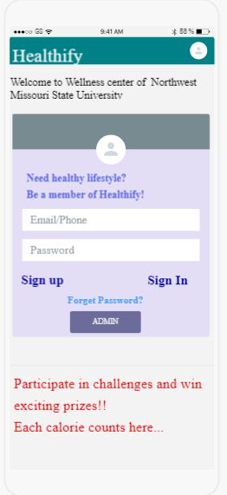
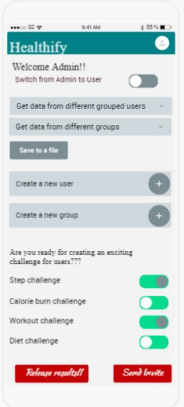
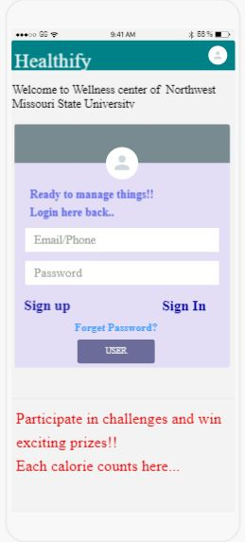
UI Sketches of Mobile Screens

Slide 6
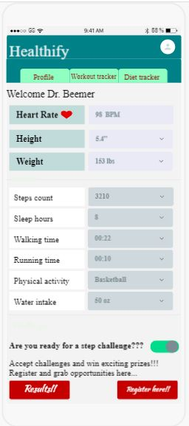
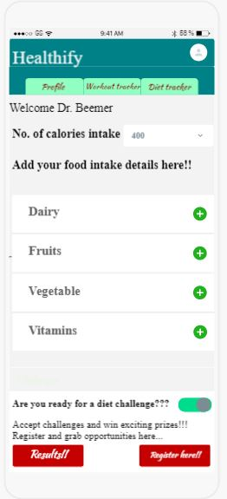
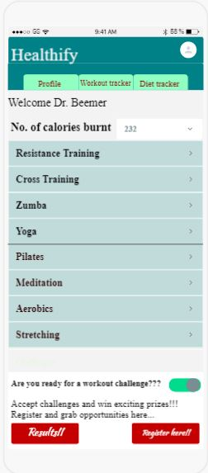
UI Sketches of Mobile Screens

Slide 7
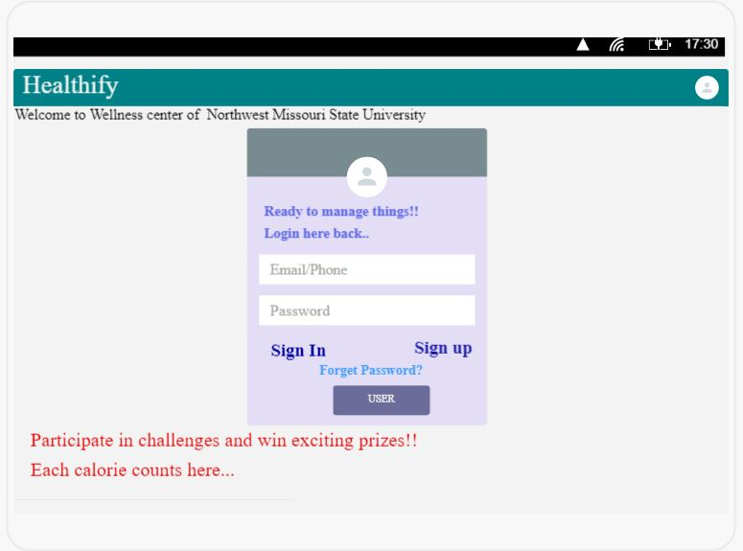
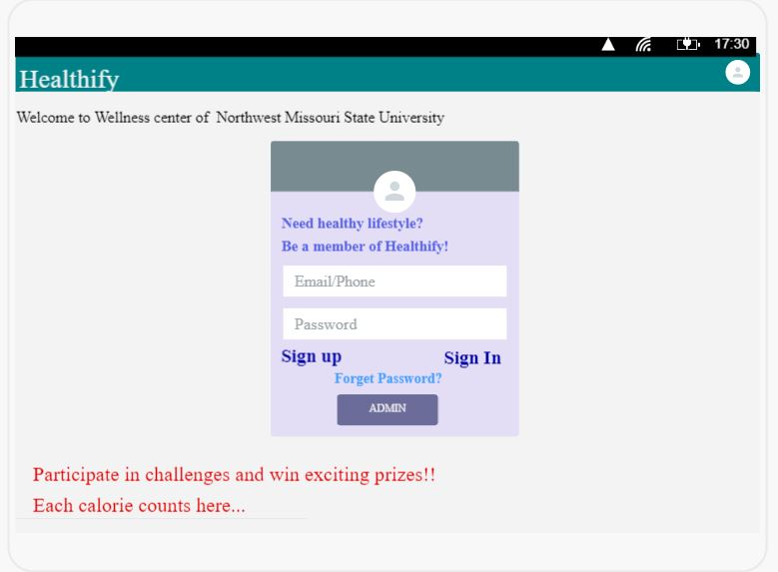
UI Sketches of Website Screens

Slide 8
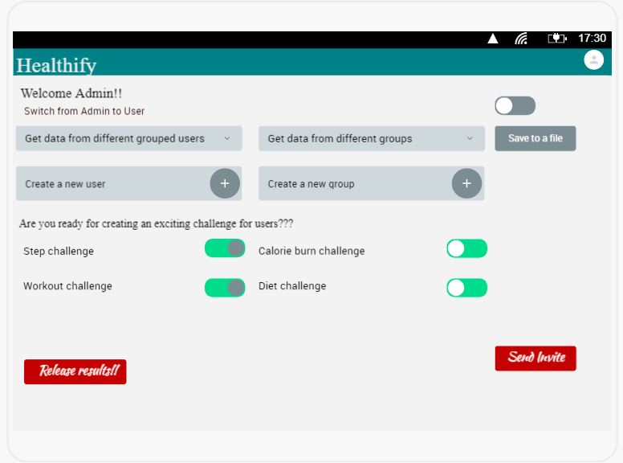
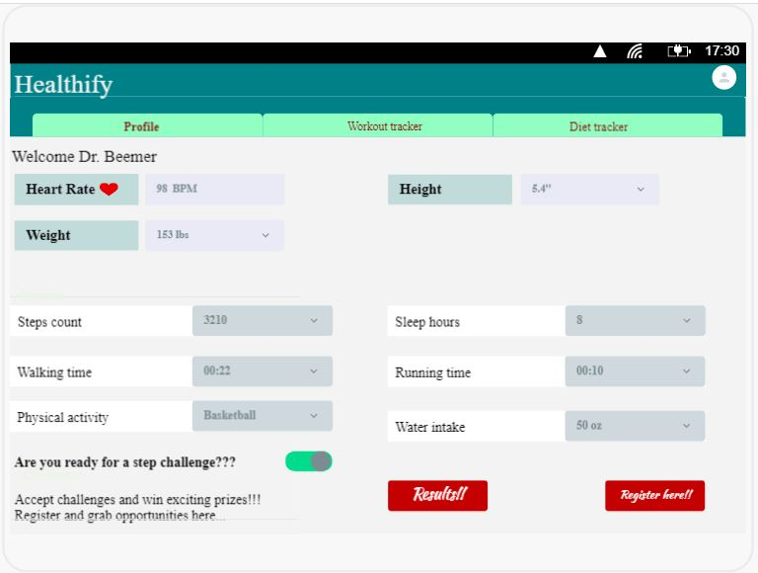
UI Sketches of Website Screens

Slide 9
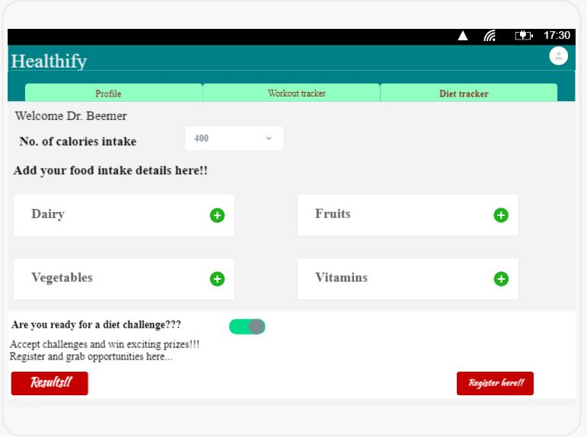
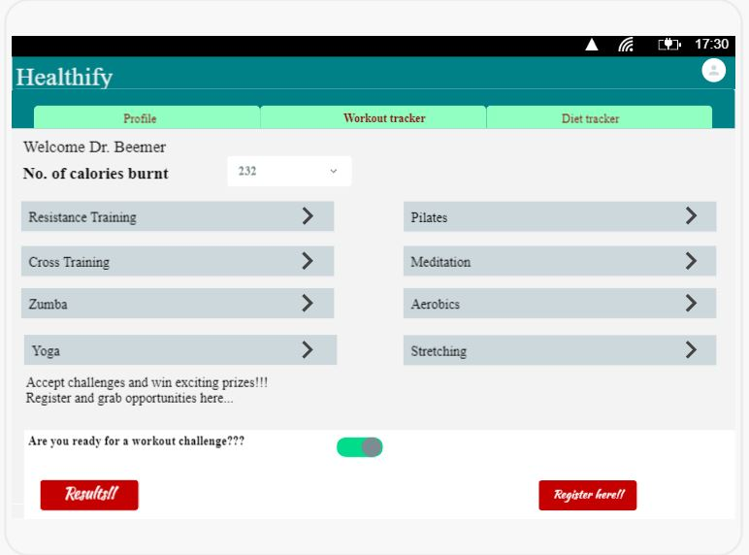
UI Sketches of Website Screens

Slide 10
Acceptance Criteria
Admin can view and download all data entered by the user by just selecting the get data into a file button.
Admin can create and manage the user groups by selecting add symbol.
Admin can share challenge results with group members by clicking release results button.
Users can create and edit data of personal details upon signup.
Users can participate in new challenges just by clicking register buttons on each page of challenges.
Users can accept or reject group assignments upon receiving mails from the admin invites.
Users can view data from past challenges by clicking on the results.
User can access the application only by submitting required details.
Enabling responsive Mobile menu for Tablets and Mobiles.
User can Easily Navigate across different screens.
User can have Responsiveness of drop-down lists.
User can Distinguish the inactive buttons from active buttons.

Slide 11
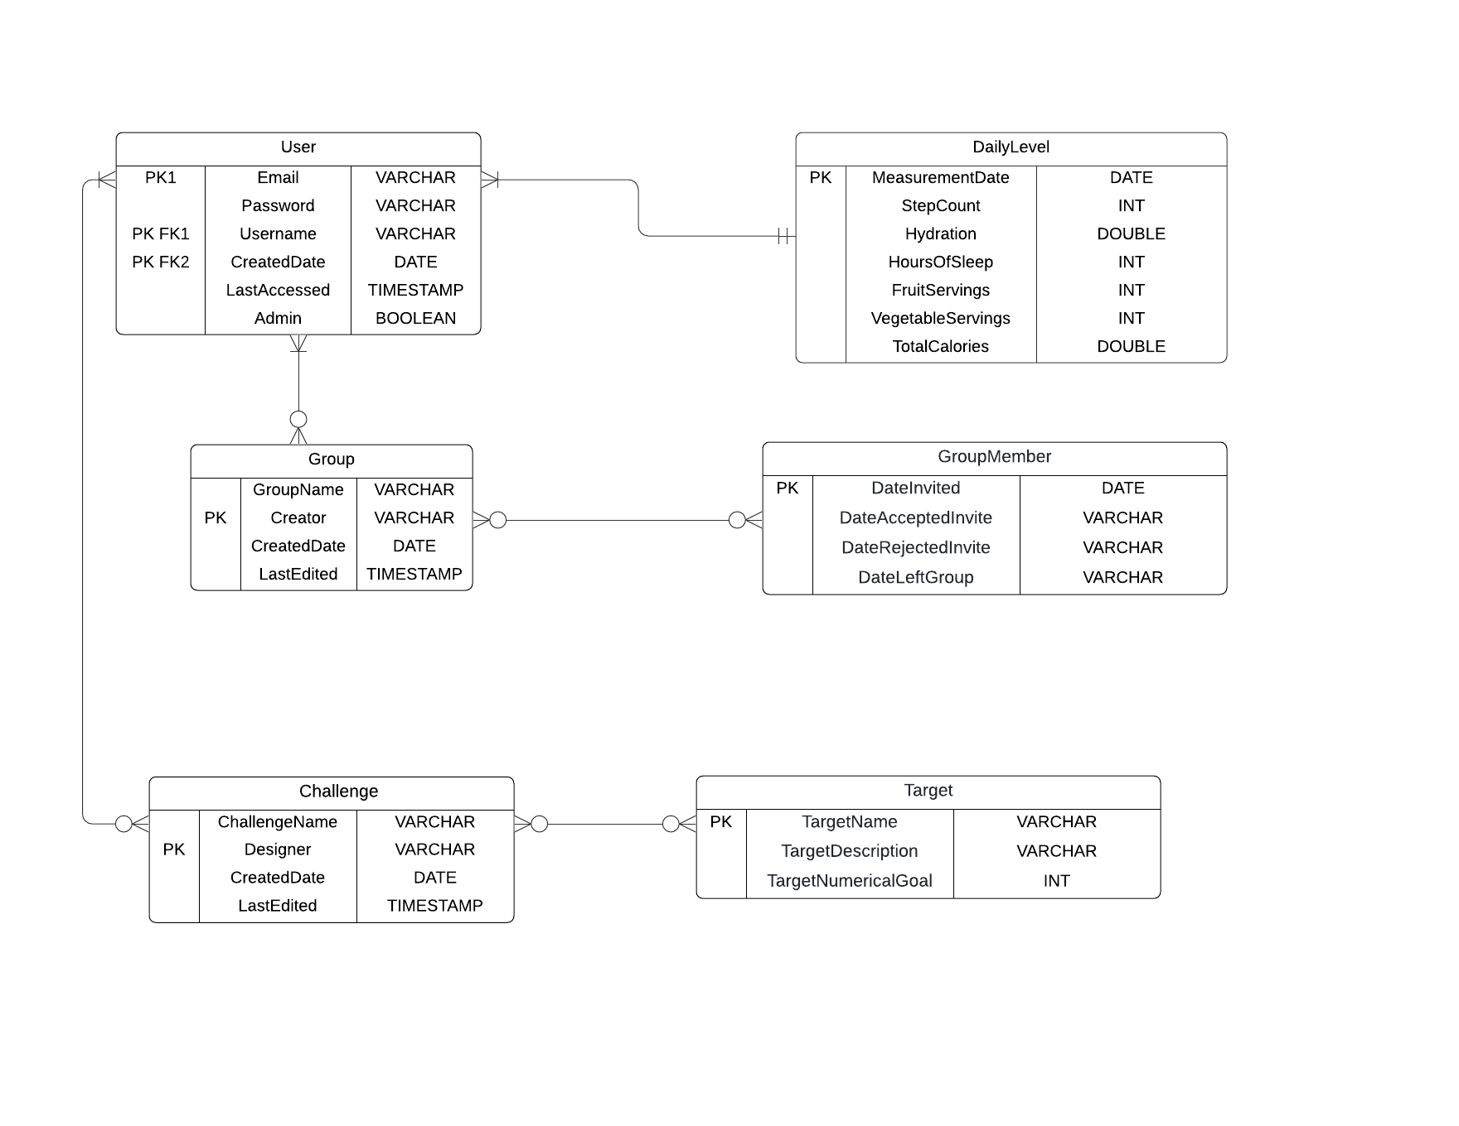
ER Diagram

Slide 12
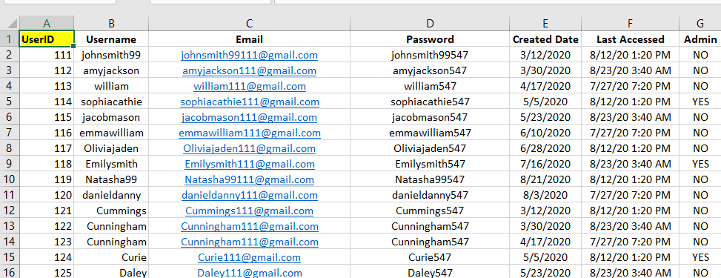
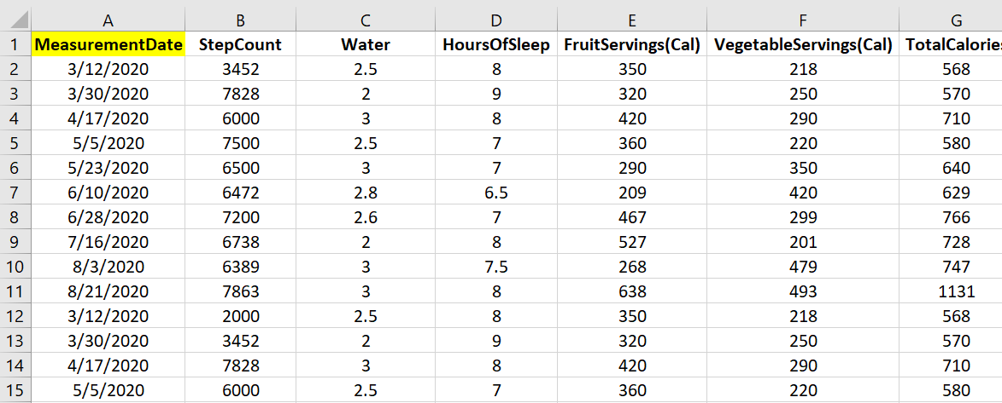
Testing
User
Daily Level

Slide 13
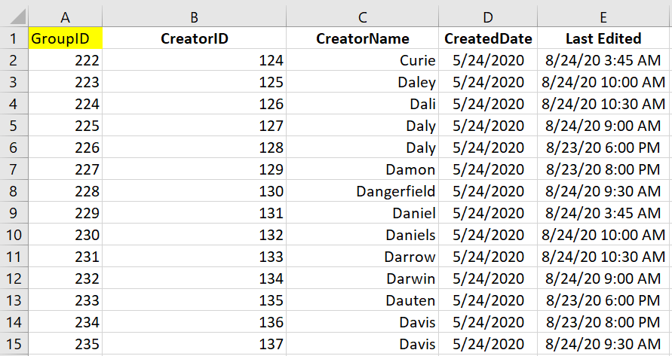
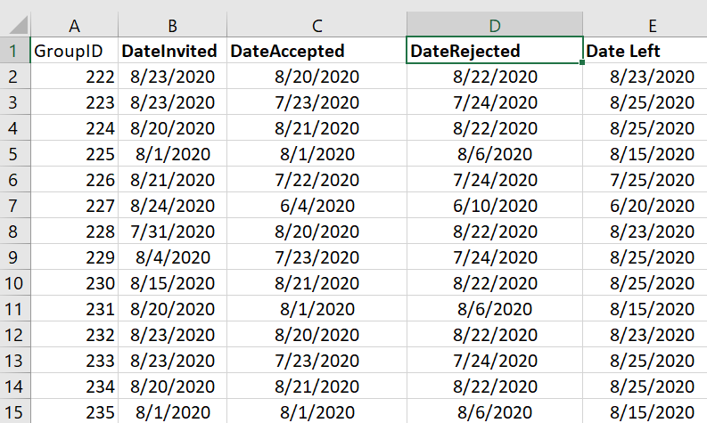
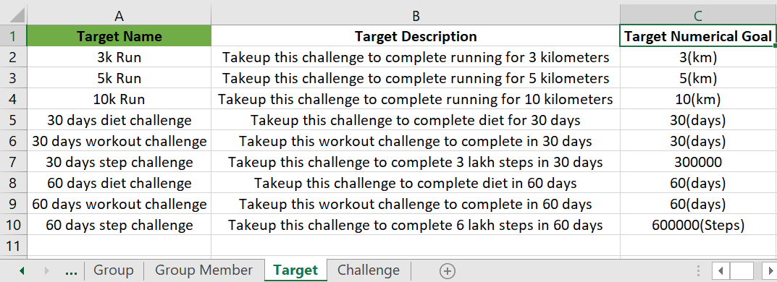
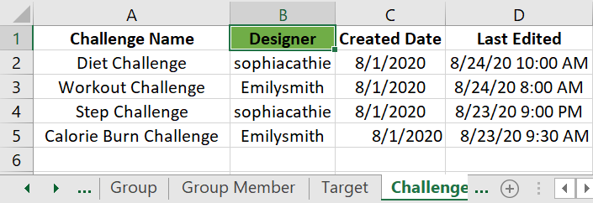
Testing
Group
Group Member
Target
Challenge

Slide 14
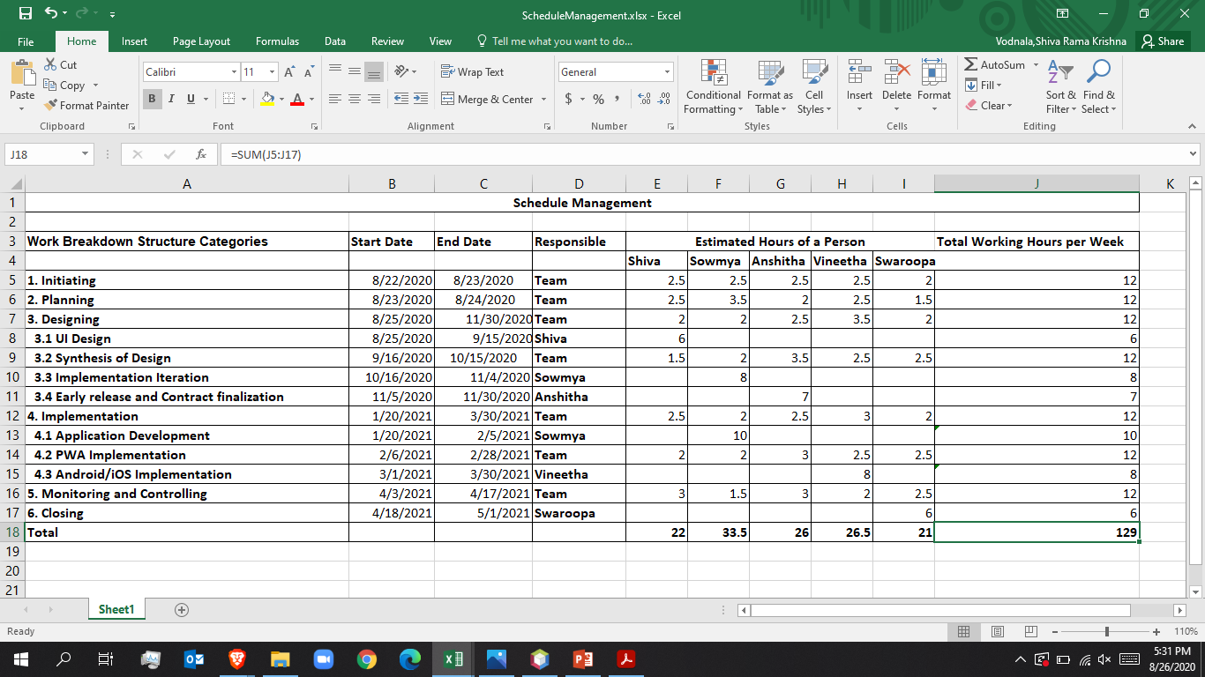
Schedule Management

Slide 15
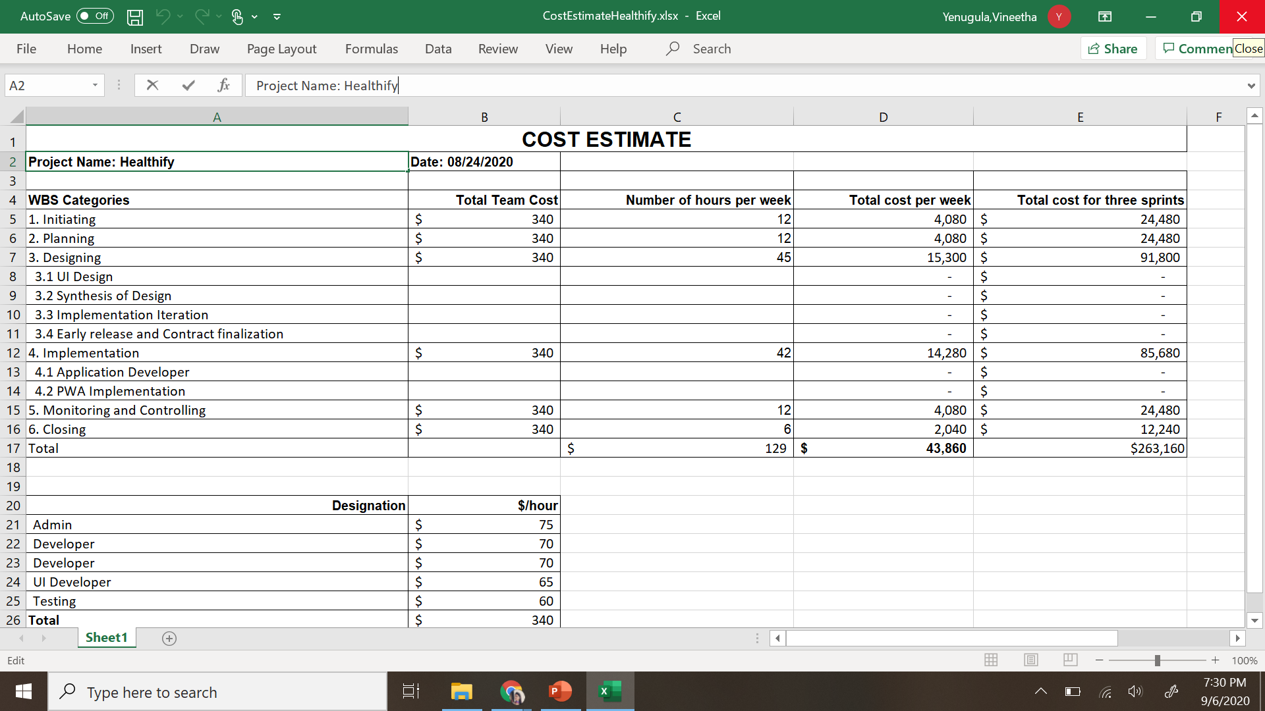
Cost Management

Slide 16
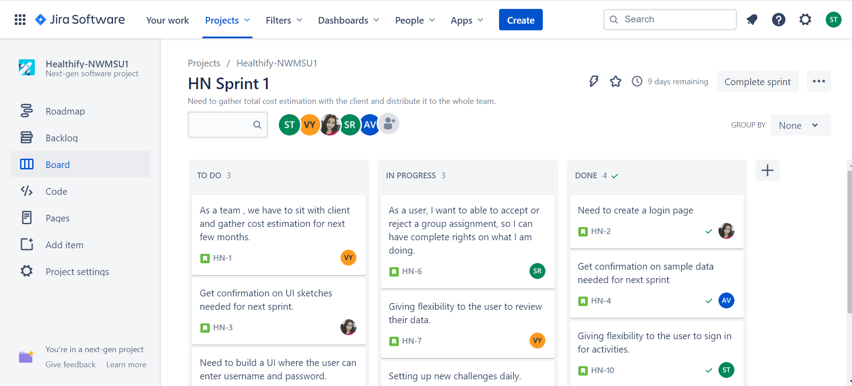
Jira Workflow

Slide 17
Benefits
Monitor your diet everyday
Track your footsteps
Track your water intake
Helps in calorie count
Set goals that you can achieve
Create your yoga studio
Easily keep track of your progress
Get free workout ideas
Heartrate tracking
Weight loss progression
Pedometer
Give free health and fitness tips
Keeps you Motivated

Slide 18
References
Jira link: https://sowmyathogiti27.atlassian.net/jira/software/projects/HN/boards/2
FluidUI Link: https://www.fluidui.com/editor/live/
Github Link: https://github.com/sowmyathogiti/Healthify-NWMSU

Slide 19
Queries…??

Slide 20


